Slide 1
Exploring biological shape analysis through topology, geometry and statistics
Ph. D. summer school: Biomedical image analysis, 2024/03/20
Jon Sporring,
Department of Computer Science

Slide 2
Imaging research and pipeline
Research loop
Image analysis pipeline
Hypothesis
Tissue preparation
Imaging
Analysis
Preprocessing
Segmentation
Post processing
Statistical summary
Bias correction
Cropping
Thresholding/deep learning
Mathematical morphology
Counting
Shape selection
Modelling

Slide 3
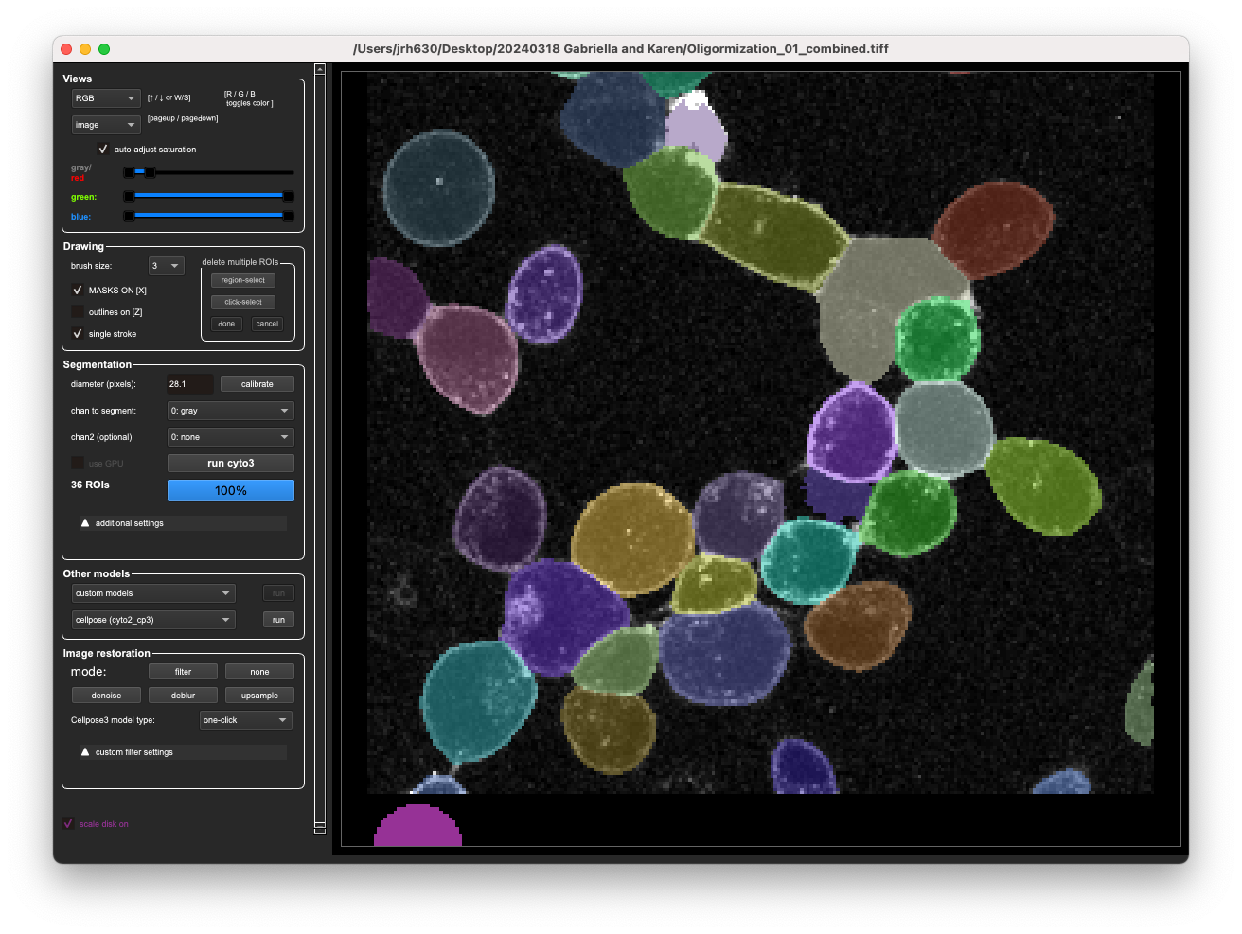
AI is pretty good at segmenting stuff, what’s next?
Image courtesy: Karen Martinez & Gabriella von Scheel von Rosing; AI: http://www.cellpose.org/

Slide 4

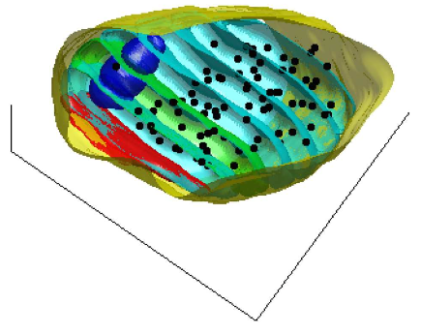
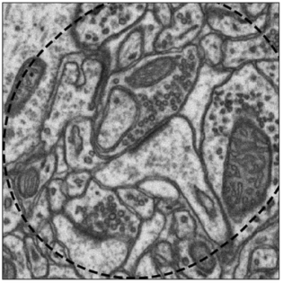
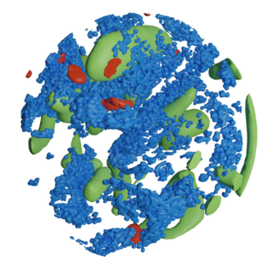
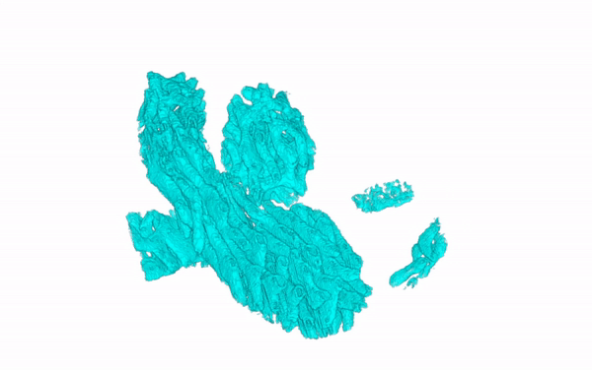
What to do next: Shape analysis
Spatial point fields
Spatial shape fields
Topological data analysis
Focused ion-beam scanning electron microsopy (FIB-SEM)
Voxel size: (5 nm)^3
Mitochondria
Vessicles
Active zone
Graham Knott and Marco Cantoni. Electron microscopy dataset. https://cvlab.epfl.ch/data/ data-em/

Slide 5
Literature
Spatial point fields
Spatial shape fields
Topological data analysis
Analysis of shape and spatial interaction of synaptic vesicles using data from focused ion beam scanning electron microscopy (FIB-SEM); M Khanmohammadi, RP Waagepetersen & J Sporring, Frontiers in Neuroanatomy, 2015
Stoyan, D. (2006). Fundamentals of Point Process Statistics. In: Baddeley, A. et al. (eds) Case Studies in Spatial Point Process Modeling. Lecture Notes in Statistics, vol 185. Springer
Mrkvička, Tomáš, et al. "A one-way ANOVA test for functional data with graphical interpretation." Kybernetika 56.3 (2020): 432-458.
Stephensen, H.J.T., Svane, A.M., Villanueva, C.B. et al. Measuring Shape Relations Using r-Parallel Sets. J Math Imaging Vis, vol 63, 2021.
Chazal F., Michel B., An Introduction to Topological Data Analysis: Fundamental and Practical Aspects for Data Scientists, In: Frontiers in Artificial Intelligence, vol 4, 2021

Slide 6

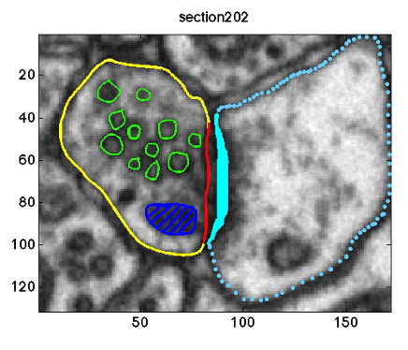
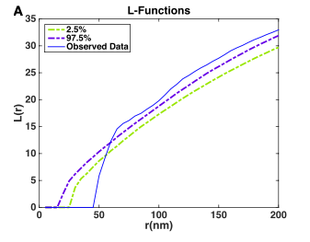
Point models
Analysis of shape and spatial interaction of synaptic vesicles using data from focused ion beam scanning electron microscopy (FIB-SEM); M Khanmohammadi, RP Waagepetersen & J Sporring, Frontiers in Neuroanatomy, 2015

Slide 7
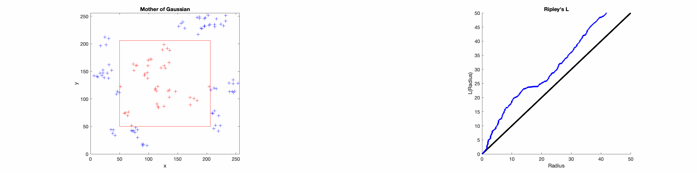
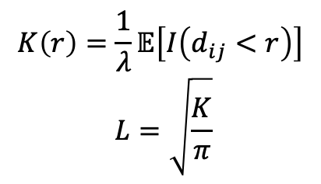
Ripley’s K- and L-functions: expected number of neighboring points by radius
$$K\left(r\right)=\frac{1}{λ}𝔼\left[I\left(d_{ij}<r\right)\right]$$
$$L=\sqrt{\frac{K}{π}}$$

Slide 8
R and rpy2 demo: https://sporring.github.io/bia2024/ demoRpy2.py
https://cran.r-project.org/
https://spatstat.org/
https://cran.r-project.org/web/packages/GET/vignettes/pointpatterns.pdf
Exercise: Use GET’s global_envelope_test to test whether x and/or z are likely to be random

Slide 9

Real structures are not points, small structures are difficult to separate
Graham Knott and Marco Cantoni. Electron microscopy dataset. https://cvlab.epfl.ch/data/ data-em/
Deep Learning
Measuring Shape Relations Using r-Parallel Sets; HJT Stephensen, AM Svane, CB Villanueva, SA Goldman, & J Sporring; Journal of mathematical imaging and vision, 2021

Slide 10
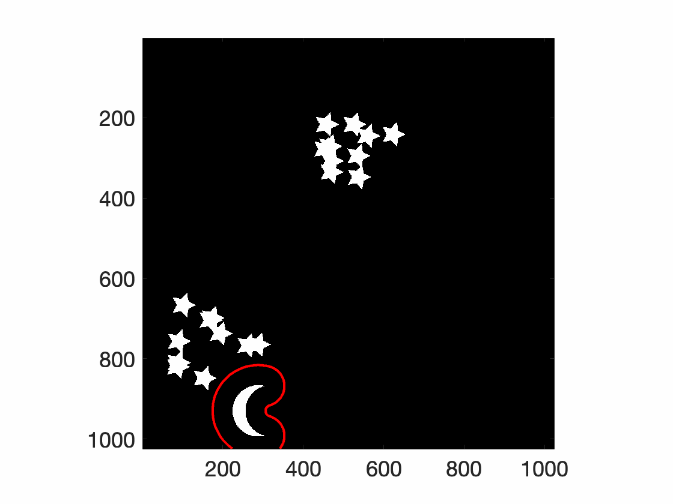
Shape relation measures: K-functions for objects

Slide 11
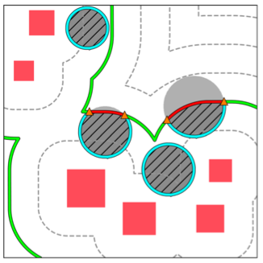
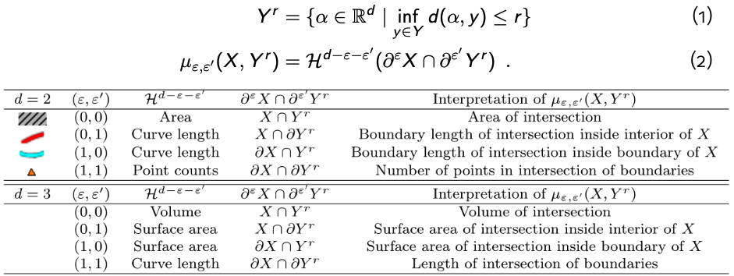
Shape relation measures: K-functions for objects
https://lab.compute.dtu.dk/QIM/tools/relationalshapemeasure

Slide 12
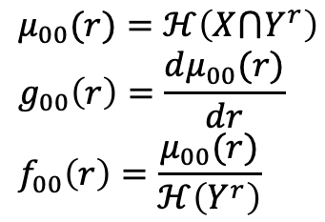
Shape relation measures: K-functions for objects
$$μ_{00}(r)=ℋ\left(X⋂Y^{r}\right) \\ g_{00}\left(r\right)=\frac{dμ_{00}(r)}{dr} \\ f_{00}\left(r\right)=\frac{μ_{00}(r)}{ℋ\left(Y^{r}\right)}$$

Slide 13
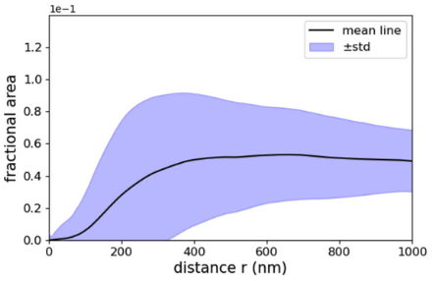
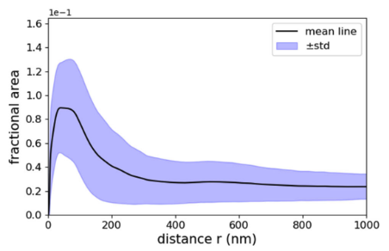
Shape relations for statistical summary of families of shapes and their relations
Active zone - mitochondria
Active zone - vessicles

Slide 14

Analyzing cristae membranes in Mitochondria
Deep Learning
Extracting Mitochondrial Cristae Characteristics from 3D Focused Ion Beam Scanning Electron Microscopy Data, C Wang, L Østergaard, S Hasselholt, & J Sporring, to appear in Communications Biology, 2024

Slide 15
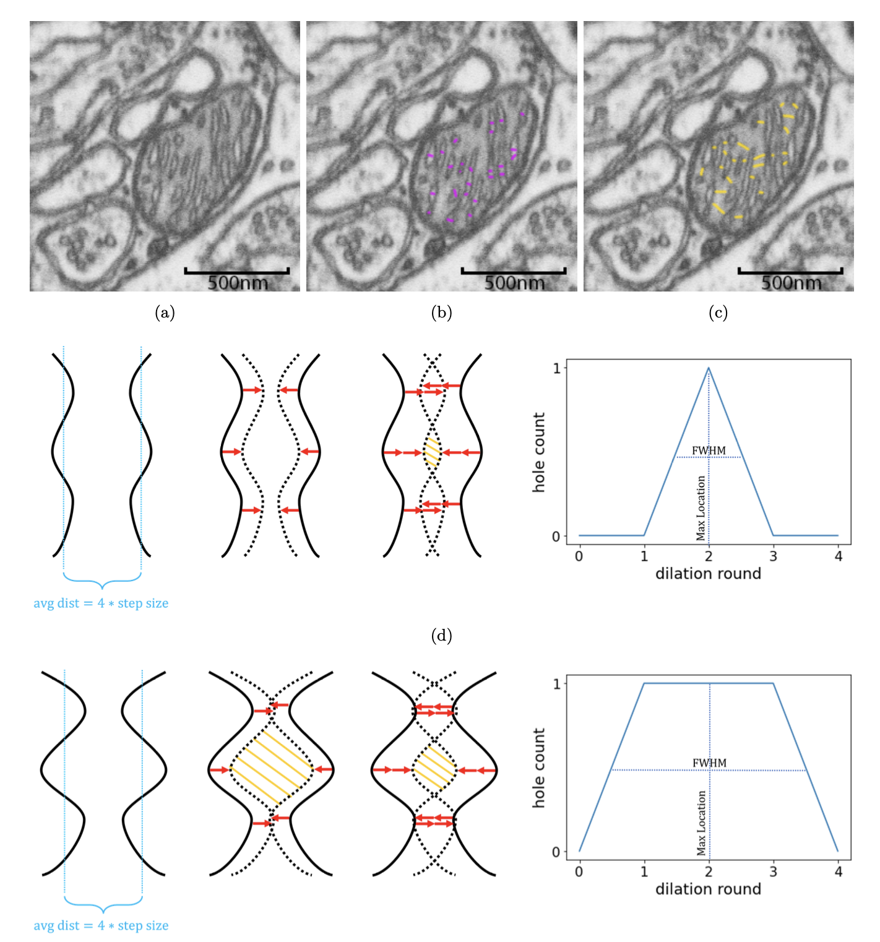
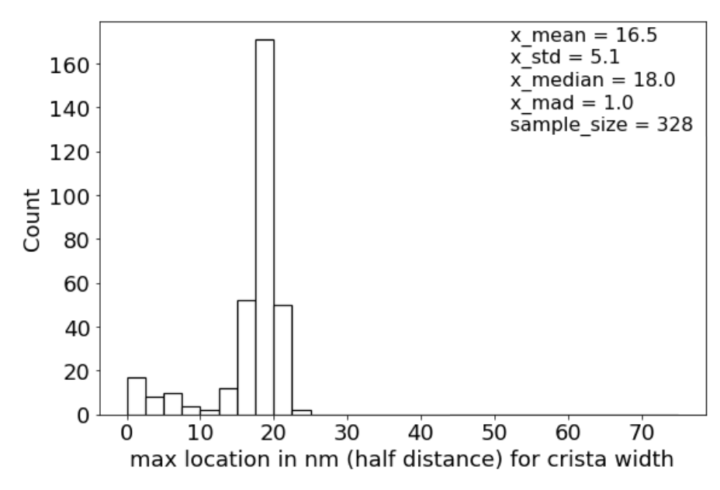
Persistent homology: Statistical measures on H_0

Slide 16
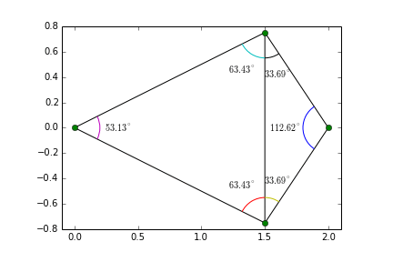
Alpha complexes = Delaunay triangulation + Vietoris-Rips
https://en.wikipedia.org/wiki/Delaunay_triangulation#/media/File:Delaunay_triangulation_does_not_minimize_edge_length.gif

Slide 17
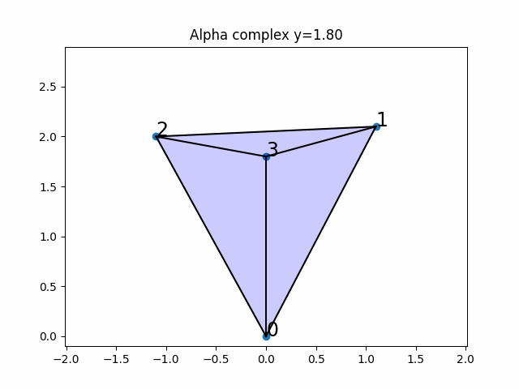
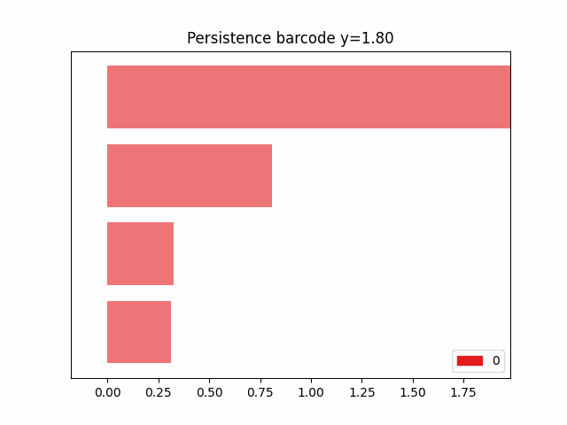
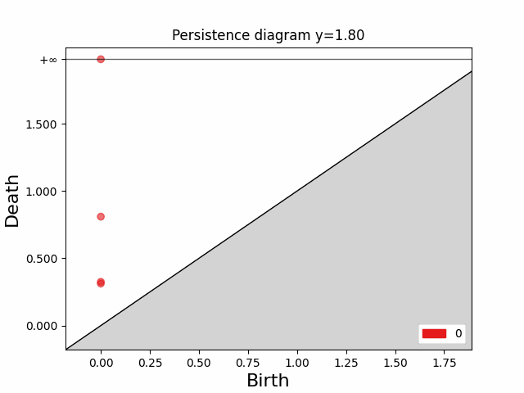
Observations on alpha complexes of 1-parameter family of 4-gons

Slide 18
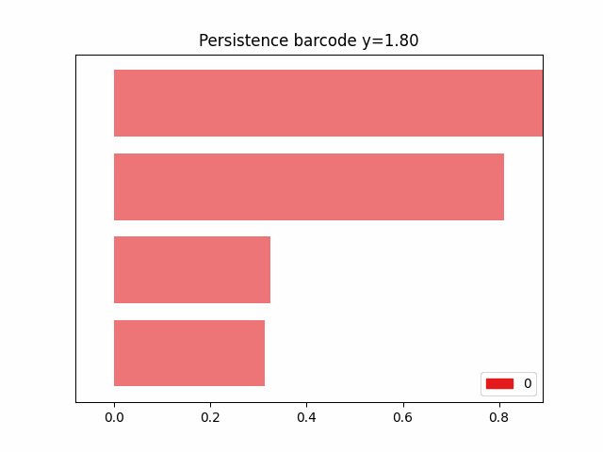
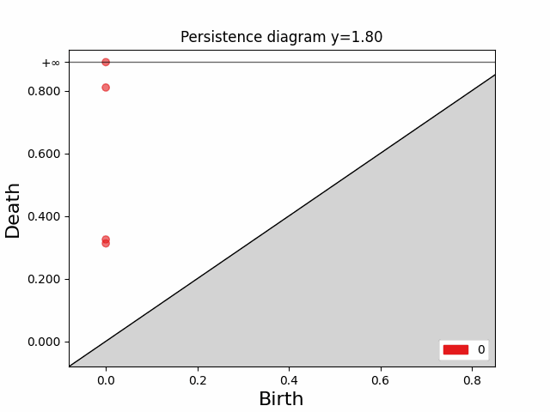
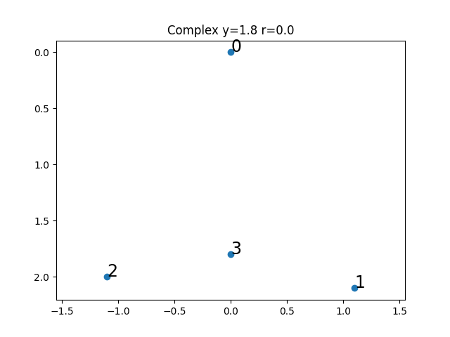
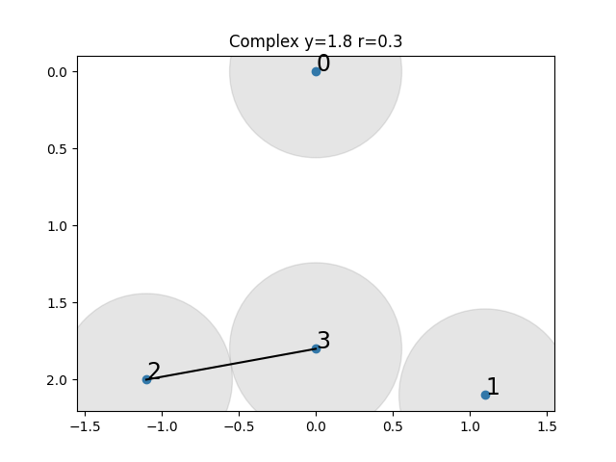
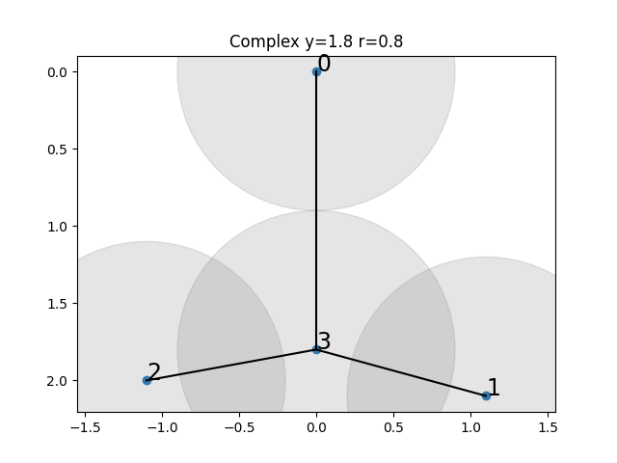
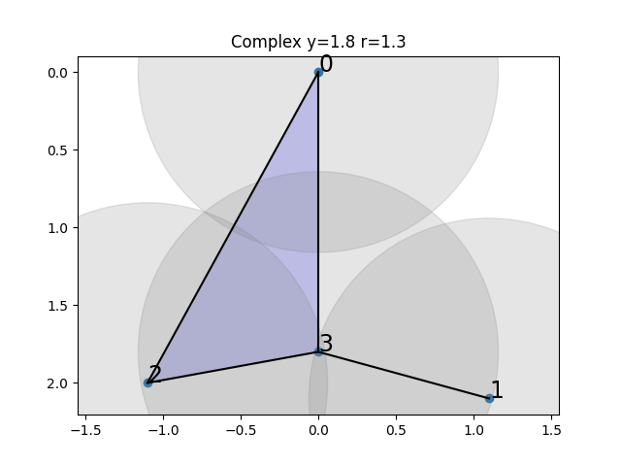
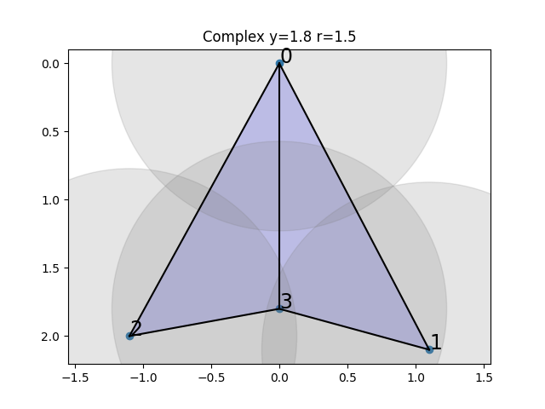
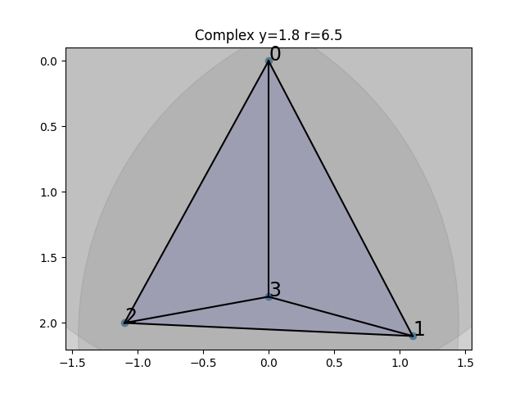
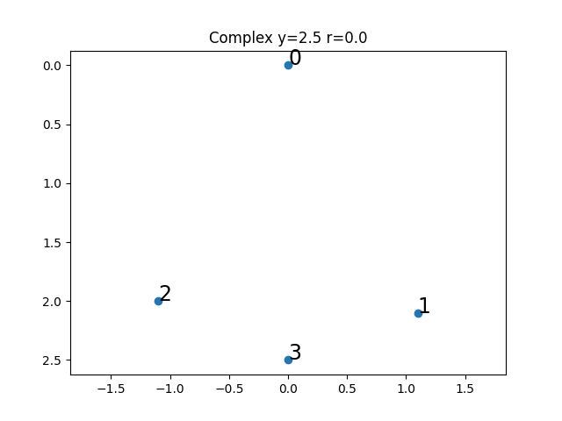
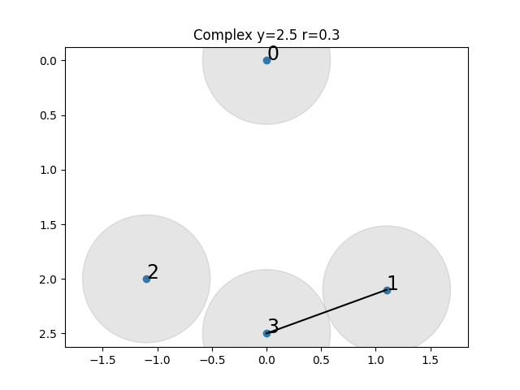
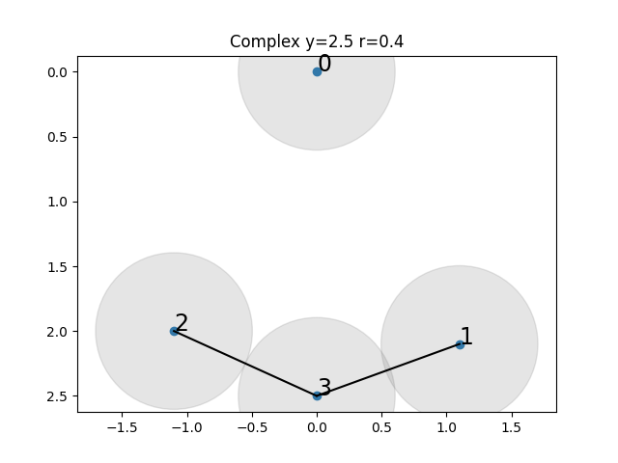
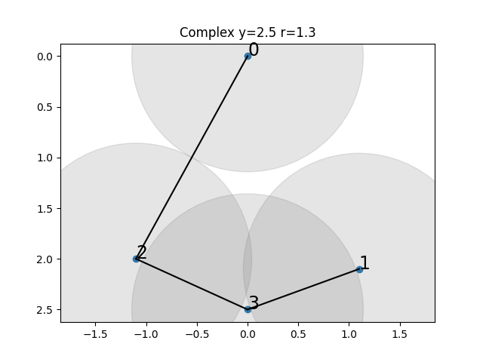
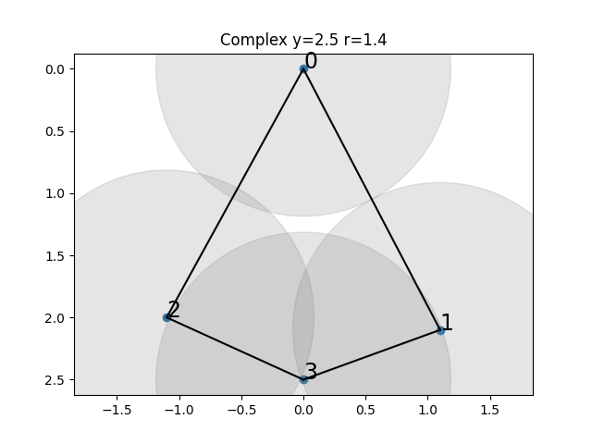
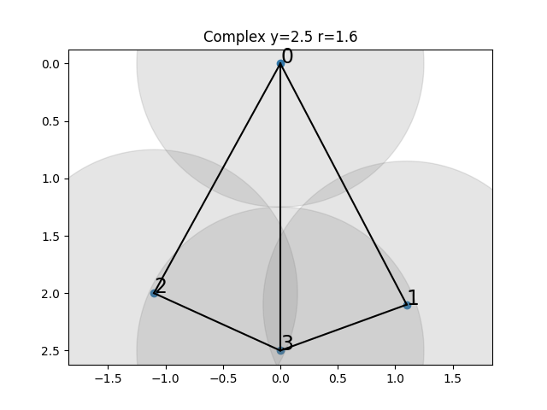
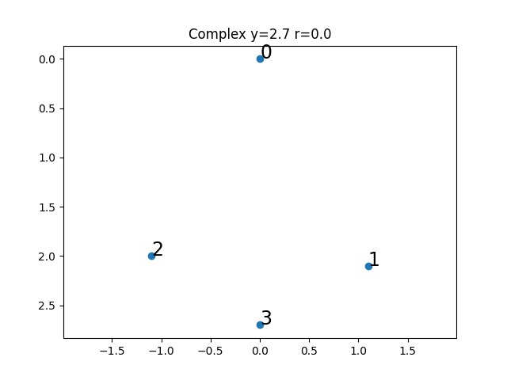
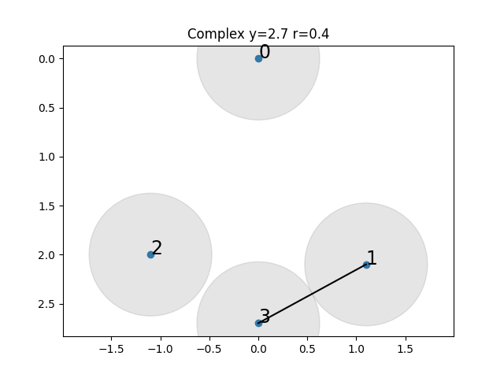
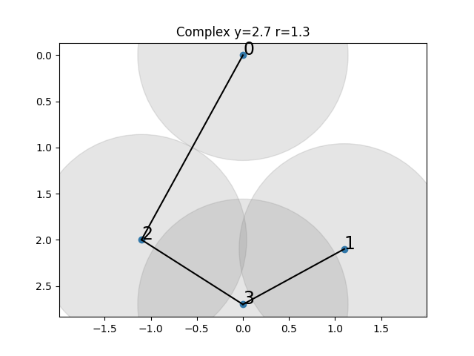
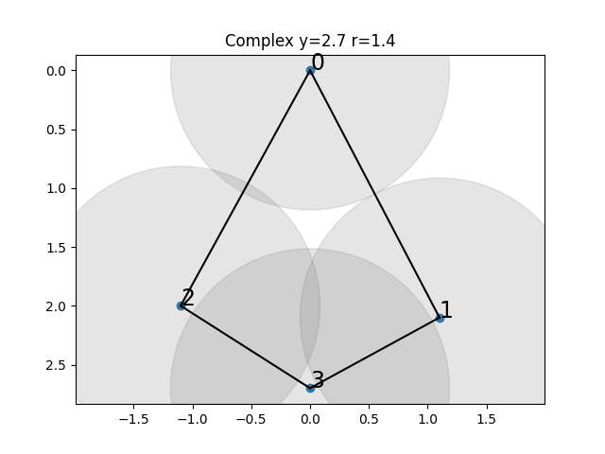
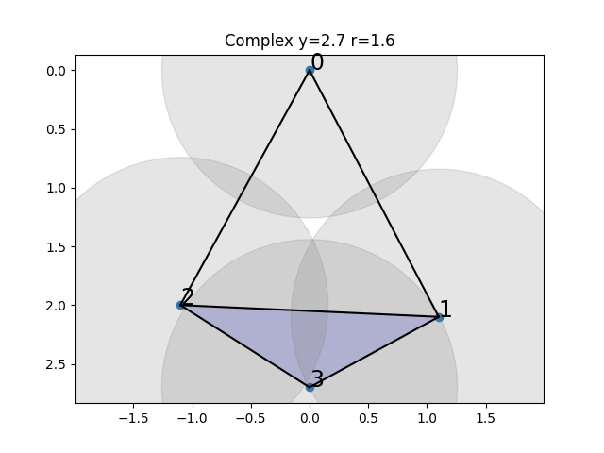
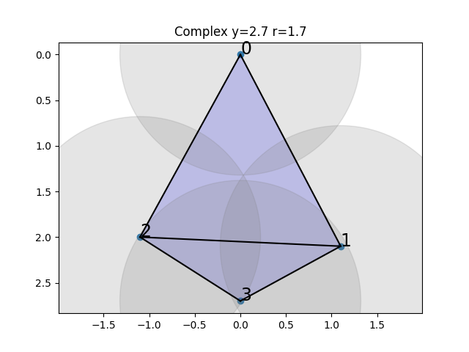
Generic cases
Observations: $H_{0}$ is continuous in $y$ but non-smooth. $H_{1}$ is same + birth and death events.

Slide 19
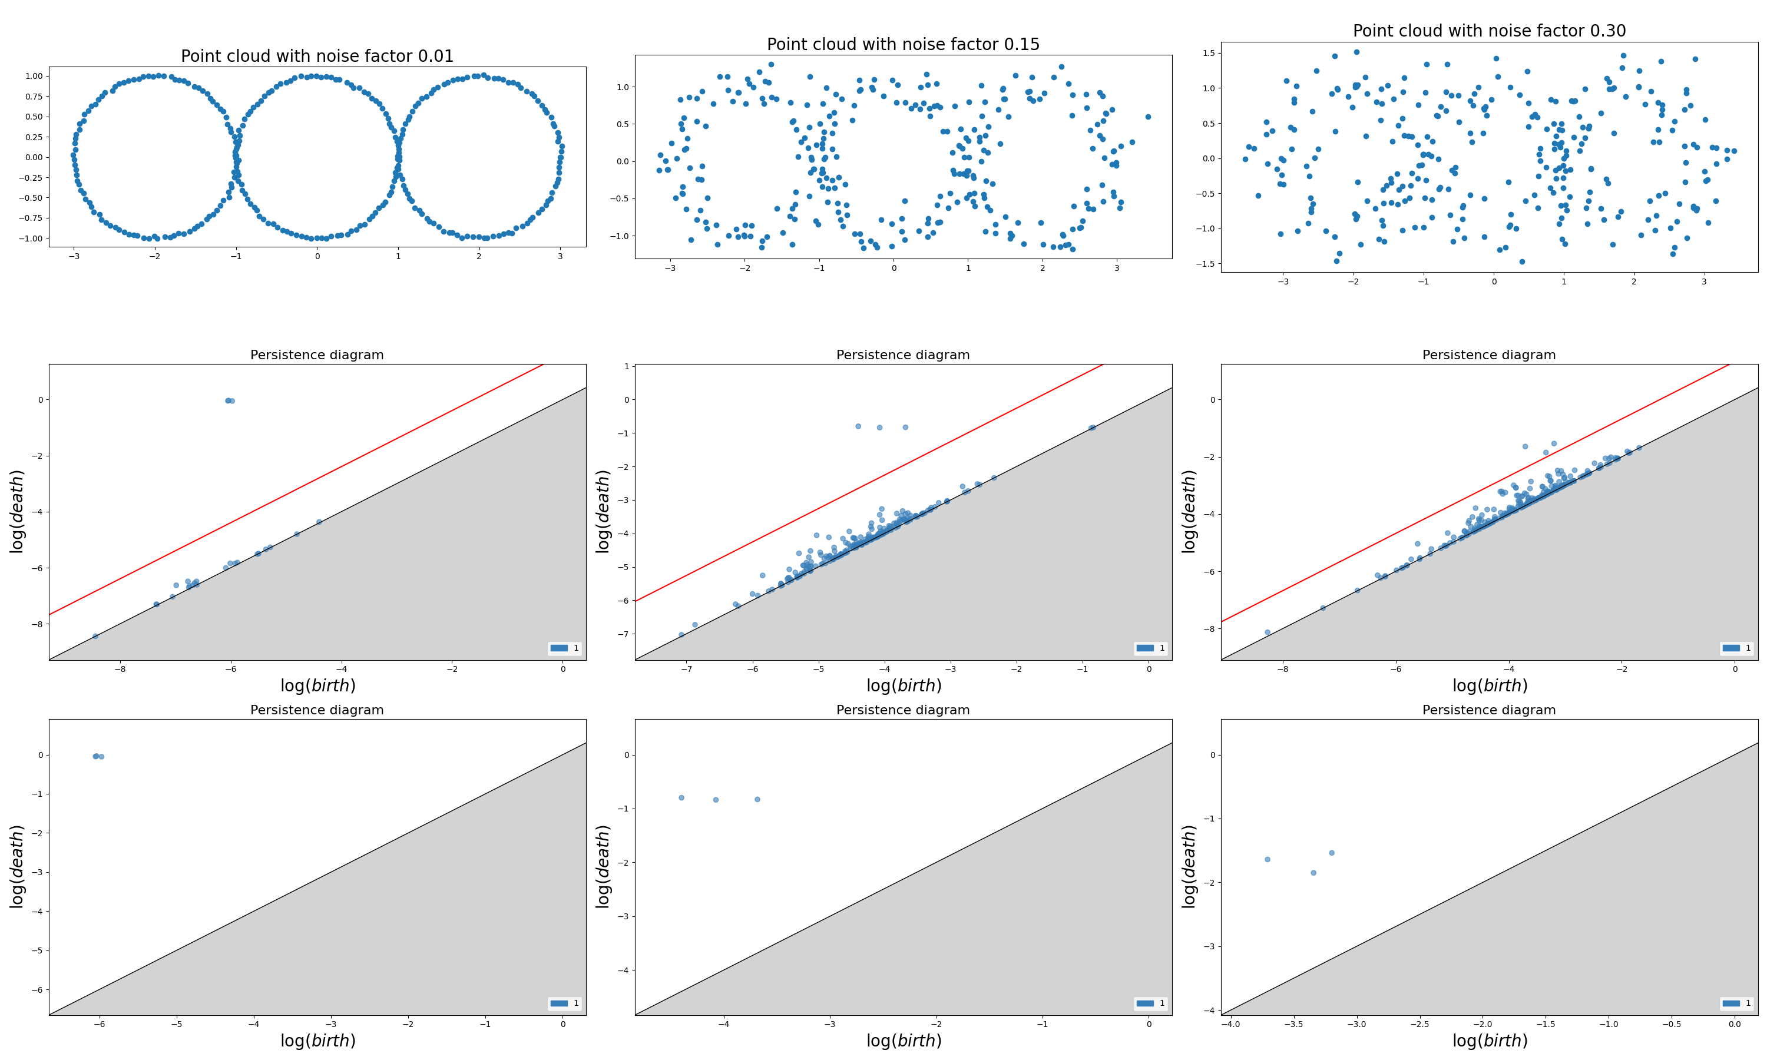
Persistence under noise: $dgm={dgm}^{Signal}∪{dgm}^{Noise}$

Slide 20
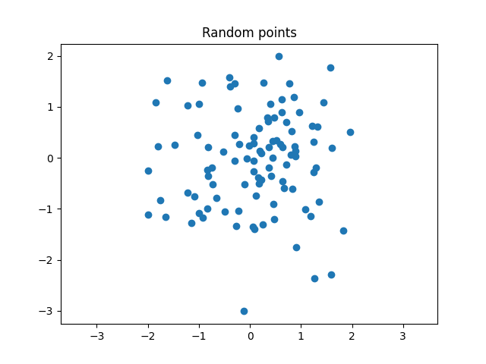
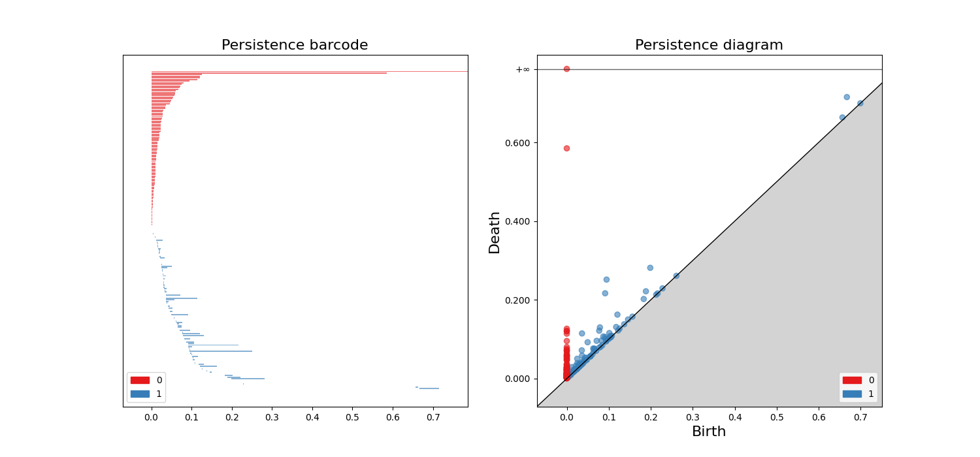
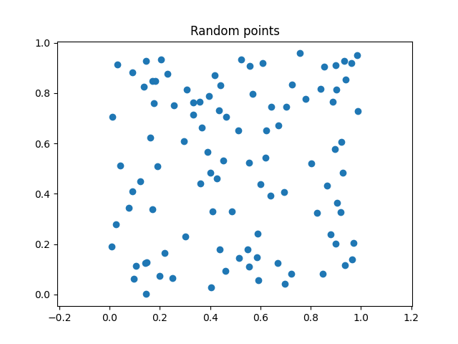
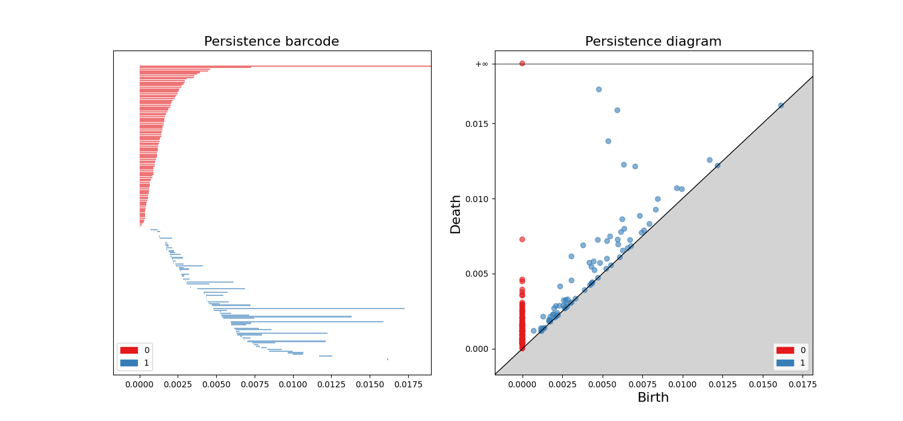
Pure noise
Normal
Uniform

Slide 21
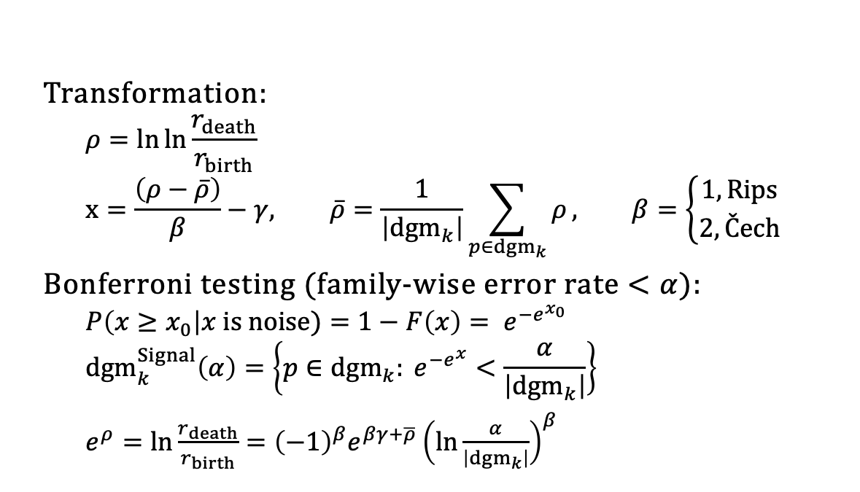
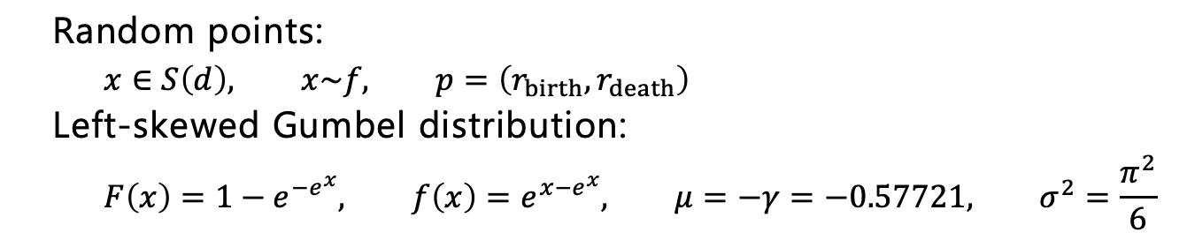
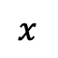
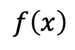
Bobrowski & Skraba, “A universal null-distribution for topological data analysis”, Nature/Scientific Reports, 2023
Random points:
$$x∈S\left(d\right), x\sim f, p=\left(r_{birth},r_{death}\right)$$
Left-skewed Gumbel distribution:
$$F\left(x\right)=1−e^{−e^{x}}, f\left(x\right)=e^{x−e^{x}}, μ=−γ=−0.57721, σ^{2}=\frac{π^{2}}{6}$$
$$f\left(x\right)$$
Transformation:
$$ρ=\ln{\ln{\frac{r_{death}}{r_{birth}}}} \\ x=\frac{\left(ρ−\overline{ρ}\right)}{β}−γ, \overline{ρ}=\frac{1}{\left|{dgm}_{k}\right|}\sum_{p∈{dgm}_{k}}{ρ}, β=\left\{\begin{matrix}1, Rips \\ 2,Čech\end{matrix}\right.$$
Bonferroni testing (family-wise error rate $<α$):
$$P\left(x≥x_{0}\right|x is noise)=1−F\left(x\right)= e^{−e^{x_{0}}} \\ {dgm}_{k}^{Signal}\left(α\right)=\left\{p∈{dgm}_{k}: e^{−e^{x}}<\frac{α}{\left|{dgm}_{k}\right|}\right\}$$ $e^{ρ}=\ln{\frac{r_{death}}{r_{birth}}}={\left(−1\right)}^{β}e^{βγ+\overline{ρ}}{\left(\ln{\frac{α}{\left|{dgm}_{k}\right|}}\right)}^{β}$
$$x$$

Slide 22


Family-wise error rate

Slide 23
The universal distribution can separate very noisy cases

Slide 24


Random sampling and outlier detection

Slide 25









Slide 26






Persistent homology and bar codes
Betti₁(r)
Simplex $σ=[x_{0},x_{1},…x_{k}]$is in the alpha complex if
$$\bigcap_{x_{i}∈σ}{B(x_{i},r)≠∅}$$
r
r

Slide 27
Persistent homology: Statistical measures on H_0

Slide 28
Statistical summary of object collections
Spatial point fields
Spatial shape fields
Topological data analysis
Pair correlation and Ripley’s K functions summarizes 1st order point relations – e.g., do the vessicles cluster?
Hausdorf measures on overlaping sets extends notion of points to shapes – e.g., are mitochondria seen close to the synapse?
Filtrations brings topological concepts to measurements - e.g., what is the average tubular radius of complicated objects

Slide 29








Pre-processing
Segmentation
Post-processing
Hypothesis
Imaging
Statistical analysis

